Slide 1
CEIS101C Module 6
Adding Automated Light to Smart Home System

Slide 2
Rubric
Activity | Requirement(s) | Points
Set up circuit | Picture of complete circuit with automated LED off | 10
Set up circuit | Picture of complete circuit with automated LED on | 20
Upload code | Screenshot of code in Arduino IDE with your name shown | 10
Run code | Screenshot of Serial Monitor with your name and messages shown | 10

Slide 3
Circuit with automated LED off

Slide 4
Circuit with automated LED on

Slide 5
Arduino Code

Slide 6
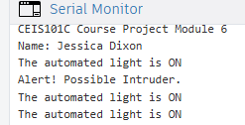
Serial Monitor
CEIS101C Course Project Module 6
Name: Jessica Dixon
The automated light is ON
Alert! Possible Intruder.
The automated light is ON
The automated light is ON
The automated light is ON
The automated light is ON
The automated light is ON
The automated light is ON
The automated light is ON
The automated light is ON
The automated light is ON

