Slide 1
CEIS101C Module 5 June2025 jdixon
Adding Distance Sensor to Smart Home System
and Conducting Data Analysis

Slide 2
Rubric
Activity | Requirement(s) | Points
Set up circuit | Picture of circuit with green LED on | 5
Set up circuit | Picture of circuit with yellow LED on | 5
Set up circuit | Picture of circuit with red LED on | 5
Upload code | Screenshot of code in Arduino IDE with your name shown | 15
Analyze data | Excel plot of data generated by distance sensor | 20

Slide 3
Circuit with green LED on

Slide 4
Circuit with yellow LED on

Slide 5
Circuit with red LED on

Slide 6
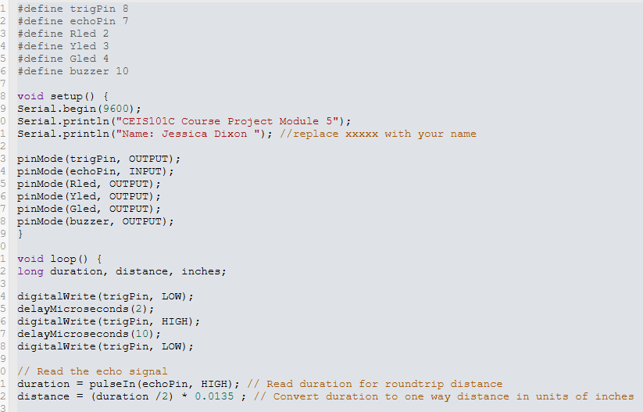
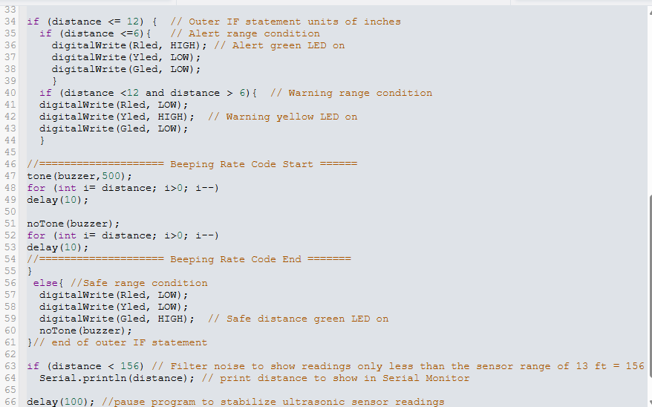
Arduino Code

Slide 7
Plot of Data

